Slide 1
Chapter 9
Going from Data to UI in React

Slide 2
Objectives
The Example
Your JSX Can Be Anywhere, Part II
Dealing with Arrays

Slide 3
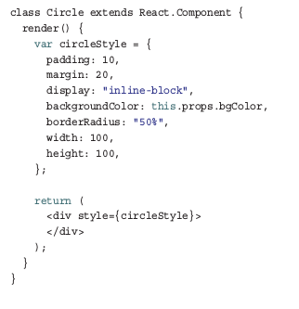
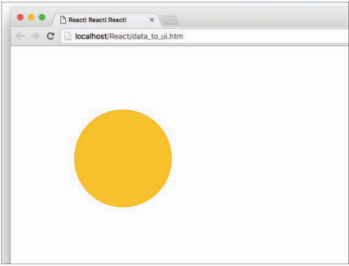
The Example
The bulk of what you see comes from the Circle component:

Slide 4
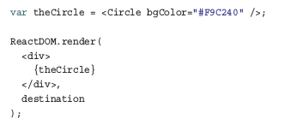
Your JSX Can Be Anywhere, Part II
In Chapter 7, “Meet JSX...Again” , you learned that JSX can actually live outside a render function and can be used as a value assigned to a variable or property. For example, we can fearlessly do something like this:

Slide 5
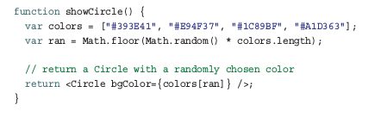
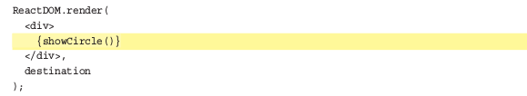
Your JSX Can Be Anywhere
Can go further and create a function that returns a Circle component:
Have to do is evaluate it inside ReactDOM.render

Slide 6
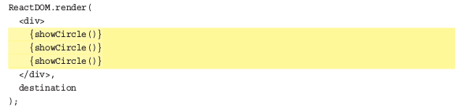

Dealing with Arrays
When you’re displaying multiple components, you can’t always manually specify them:
In many real-world scenarios, the number of components you display is related to the number of items in an array or array like object you’re working with.

Slide 7
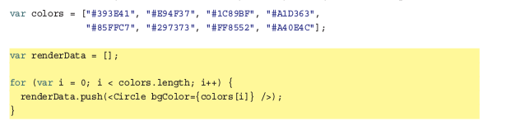
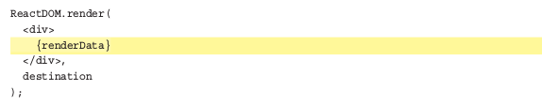
Dealing with Arrays
We want to create a Circle component for each item in this array. We can do this by creating an array of Circle components:
React makes displaying all of these components very simple.

Slide 8

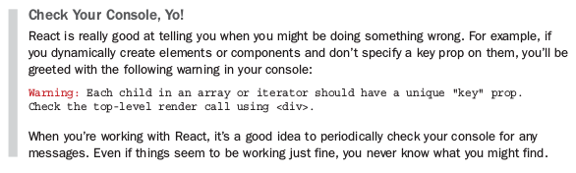
Dealing with Arrays
That extra work takes the form of a key prop whose value React uses to uniquely identify each particular component.

Slide 9
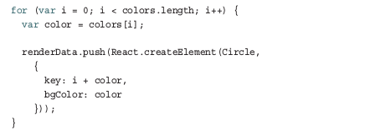
Conclusion
JSX is JavaScript. This is what allows you to have your JSX live wherever JavaScript thrives.
Even though we’re pushing pieces of JSX to an array, just like magic, everything works in the end when renderData is evaluated inside our render method. I hate to sound like a broken record, but this is because what our browser ultimately sees looks like this:

